Slide 1

"A comprehensive MySQL-based analysis of global video game sales data, exploring trends across platforms, genres, publishers, and regional markets through structured database queries and insights."
Video Game Sales Database Analysis
A comprehensive SQL-based analysis of global video game sales data, exploring trends across platforms, genres, publishers, and regional markets through structured database queries and insights.
BY SUPRATIM MAITY

Slide 2

Project Overview
This project explores video game sales performance data to analyze global trends, regional strengths, top publishers, and platform success. It utilizes SQL queries to extract insights from historical sales data, enabling better business and strategic decision-making in the gaming industry.

Slide 3
Business Objectives
The main business objectives of this project are:
📊 Understand Global Sales Performance
🏢 Evaluate Publisher Success
🎮 Discover Genre & Platform Popularity
Identify top-performing publishers and those underperforming relative to the global average.
Determine which genres and platforms drive the most sales globally and regionally.
Measure total and regional sales trends over time to identify growth opportunities.
🌍 Analyze Regional Market Dynamics
💰 Optimize Marketing & Release Strategies
📈 Track Yearly Growth & Industry Trends
Understand how preferences differ across North America, Europe, Japan, and other regions.
Use insights to guide marketing focus, regional targeting, and platform-specific releases.
Identify years with significant growth or decline to forecast future sales potential.

Slide 4

Database Design
Database Creation
CREATE DATABASE IF NOT EXISTS video_game_sales_db;
USE video_game_sales_db;
Table Creation
CREATE TABLE IF NOT EXISTS video_games (
game_id INT AUTO_INCREMENT PRIMARY KEY,
name VARCHAR(150) NOT NULL,
platform VARCHAR(50) NOT NULL,
year YEAR,
genre VARCHAR(50) NOT NULL,
publisher VARCHAR(100),
na_sales DECIMAL(6,2) DEFAULT 0,
eu_sales DECIMAL(6,2) DEFAULT 0,
jp_sales DECIMAL(6,2) DEFAULT 0,
other_sales DECIMAL(6,2) DEFAULT 0,
global_sales DECIMAL(6,2) DEFAULT 0
);
Data Cleaning
UPDATE video_games
SET year = 1979
WHERE year = 0;
Insight: Ensures data consistency by correcting invalid year entries.

Slide 5

Analytical Queries and Insights
The following queries provide deep insights into video game sales patterns, market trends, and performance metrics across different dimensions including time, geography, platforms, and publishers.

Slide 6
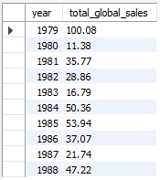

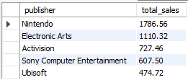
1️⃣ Total Global Sales per Year
SELECT year, ROUND(SUM(global_sales),2) AS total_global_sales
FROM video_games
GROUP BY year
ORDER BY year ASC;
OUTPUT->
Insight: Identifies overall growth trends and highlights peak sales years.
2️⃣ Top 5 Publishers by Total Sales
SELECT publisher, ROUND(SUM(global_sales),2) AS total_sales
FROM video_games
GROUP BY publisher
ORDER BY total_sales DESC
LIMIT 5;
OUTPUT->
Insight: Determines the industry's leading publishers by total sales volume.

Slide 7
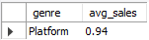

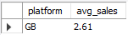
3️⃣ Most Popular Genre by Average Global Sales
SELECT genre, ROUND(AVG(global_sales),2) AS avg_sales
FROM video_games
GROUP BY genre
ORDER BY avg_sales DESC
LIMIT 1;
OUTPUT->
Insight: Identifies the genre that consistently generates the highest sales globally.
4️⃣ Platform with the Highest Average Sales
SELECT platform, ROUND(AVG(global_sales),2) AS avg_sales
FROM video_games
GROUP BY platform
ORDER BY avg_sales DESC
LIMIT 1;
OUTPUT->
Insight: Highlights which gaming console or platform delivers the best average performance.

Slide 8
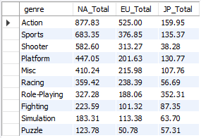

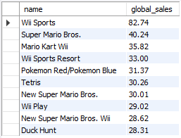
5️⃣ Regional Performance by Genre
SELECT genre,
ROUND(SUM(na_sales),2) AS NA_Total,
ROUND(SUM(eu_sales),2) AS EU_Total,
ROUND(SUM(jp_sales),2) AS JP_Total
FROM video_games
GROUP BY genre
ORDER BY NA_Total DESC;
OUTPUT->
Insight: Reveals regional preferences and strengths of specific genres.
6️⃣ Games with Sales Above Average (Global)
SELECT name, global_sales
FROM video_games
WHERE global_sales > (SELECT AVG(global_sales) FROM video_games)
ORDER BY global_sales DESC;
OUTPUT->
Insight: Lists games performing above the industry's global average.

Slide 9
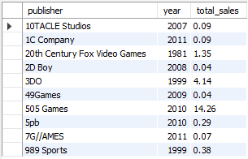

7️⃣ Best Year for Each Publisher
SELECT publisher, year, ROUND(SUM(global_sales),2) AS total_sales
FROM video_games
GROUP BY publisher, year
HAVING total_sales = (
SELECT MAX(total_sales_sub)
FROM (
SELECT publisher AS pub, year AS yr, SUM(global_sales) AS total_sales_sub
FROM video_games
GROUP BY publisher, year
) AS sub
WHERE sub.pub = publisher
)
ORDER BY publisher;
OUTPUT->
Insight: Identifies the peak performance year for each publisher.

Slide 10
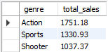

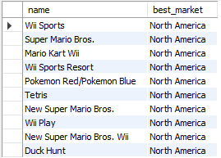
8️⃣ Top 3 Genres by Total Global Sales
SELECT genre, ROUND(SUM(global_sales),2) AS total_sales
FROM video_games
GROUP BY genre
ORDER BY total_sales DESC
LIMIT 3;
OUTPUT->
Insight: Highlights the top-performing genres in the global market.
9️⃣ Regional Leader (CASE Condition)
SELECT
name,
CASE
WHEN na_sales >= GREATEST(eu_sales, jp_sales, other_sales) THEN 'North America'
WHEN eu_sales >= GREATEST(na_sales, jp_sales, other_sales) THEN 'Europe'
WHEN jp_sales >= GREATEST(na_sales, eu_sales, other_sales) THEN 'Japan'
ELSE 'Other Regions'
END AS best_market
FROM video_games;
OUTPUT->
Insight: Identifies the strongest region for each game based on sales.

Slide 11
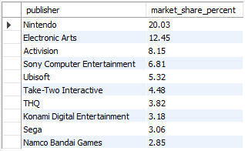
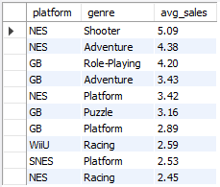
🔟 Publisher Market Share (Global %)
SELECT publisher,
ROUND((SUM(global_sales) / (SELECT SUM(global_sales) FROM video_games) * 100), 2) AS market_share_percent
FROM video_games
GROUP BY publisher
ORDER BY market_share_percent DESC;
OUTPUT->
Insight: Shows each publisher's share of the total global sales market.
1️⃣1️⃣ Average Global Sales by Platform and Genre
SELECT platform, genre, ROUND(AVG(global_sales),2) AS avg_sales
FROM video_games
GROUP BY platform, genre
ORDER BY avg_sales DESC;
OUTPUT->
Insight: Uncovers the best combinations of genre and platform for profitability.

Slide 12
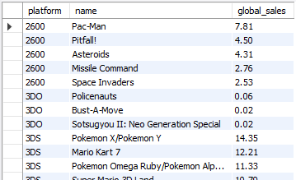
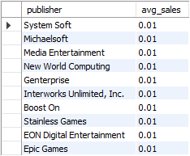
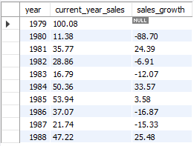
1️⃣2️⃣ Top 5 Games for Each Platform
SELECT platform, name, global_sales
FROM (
SELECT
platform,
name,
global_sales,
ROW_NUMBER() OVER (PARTITION BY platform ORDER BY global_sales DESC) AS rank_per_platform
FROM video_games
) ranked
WHERE rank_per_platform <= 5
ORDER BY platform, global_sales DESC;
OUTPUT->
Insight: Displays the top 5 selling games per platform efficiently using window functions.
1️⃣3️⃣ Identify Underperforming Publishers
SELECT publisher, ROUND(AVG(global_sales),2) AS avg_sales
FROM video_games
GROUP BY publisher
HAVING avg_sales < (SELECT AVG(global_sales) FROM video_games)
ORDER BY avg_sales ASC;
OUTPUT->
Insight: Highlights publishers whose average sales fall below industry average.
1️⃣4️⃣ Yearly Growth Trend (Sales Change)
SELECT t1.year, t1.total_sales AS current_year_sales,
(t1.total_sales - t2.total_sales) AS sales_growth
FROM (
SELECT year, SUM(global_sales) AS total_sales
FROM video_games
GROUP BY year
) t1
LEFT JOIN (
SELECT year, SUM(global_sales) AS total_sales
FROM video_games
GROUP BY year
) t2 ON t1.year = t2.year + 1
ORDER BY t1.year ASC;
OUTPUT->
Insight: Measures year-over-year change to assess growth or decline in global sales.

Slide 13
Key Insights and Business Conclusions
🎯 Top Publishers Dominate
📈 Industry Growth
A few global publishers (e.g., Nintendo, EA, Activision) account for most sales.
Most years show upward growth, highlighting expanding global demand.
💡 Genre Leaders
⚖️ Underperforming Publishers
Action, Sports, and Shooter games are top genres across all regions.
Smaller publishers have low global reach — indicating potential for mergers, marketing investment, or niche focus.
🕹️ Platform Performance
🧭 Strategic Outlook
PlayStation and Nintendo systems lead in global and regional performance.
Focus development on high-performing genres and platforms.
🌎 Regional Variations
Tailor releases for regional audience preferences.
North America favors Action and Sports.
Support weaker markets with marketing or localization strategies.
Japan shows strong preference for Role-Playing Games (RPGs).
Europe leans toward Racing and Sports titles.

Slide 14

THANK YOU

